Slide 1
A time-series analysis of the use of opioid medications in a network of Brazilian hospitals, 2009–2020
Carvalho, R.M., Bastos, F.I., de Magalhães-Barbosa, M.C., Bianchi, L.M., Robaina, J.R., Rodrigues-Santos, G., da Cunha, A.J.L.A. and Prata-Barbosa, A.
Ainsley Carlson 29 July 2025

Slide 2
Introduction
No studies have described the defined daily dose patterns of in hospital use in Brazil
No studies have assessed the trends over time of different hospitals
Increasing use of opioids outside of hospital settings have raised concern globally
Opioid are associated with serious adverse events
Studies suggest that for many initial exposure occurs in hospitals

Slide 3
Data Background
Years
January 1 2009 to December 31 2020
Location
States of the São Paulo, Rio de Janeiro, Pernambuco, and the Federal District in Brazil
Data Source
Patients 18+ in 28 hospitals in the D’Or São Luiz Network

Slide 4
Method
Prescribed Dose= Dose Prescribed subtracting what was returned to the pharmacy
DDD = 100 x total monthly amount of medication (100 patients − day) (used /established drug DDD × patients − day )
  DDD: defined daily dose
Analysis conducted in Joinpoint Regression Program Version 5.0.2

Slide 5
Time Series Analysis
Highlight inflection points and correct for first-order autocorrelation
Lerman’s grid search was used to fit the segmented regression function
Explored segments using Monte Carlo permutation test to choose the model with the best fit
Started with 0 inflection points and tested whether additional jointpoints improved the overall fit of the model
The most parsimonious model was defined by the ratio of the sum of the squared errors of the null model (SSEN) to the equivalent of an alternative model (SSEA)
  Non-Significant values represent a stationary trend

Slide 6
Trends of 12 Opioids
2009-2012
5 increasing trends
2013-2016
4 increasing trends
2017-2020
1 increasing trends
3 decreasing trends
4 stationary or mixed trends
5 decreasing trends
3 stationary or mixed trends
6 decreasing trends
5 stationary or mixed trends
Difference in DDD/100
7 increased
decreased
1 stayed the same

Slide 7
Significant Results
Parental tramadol was the most used by 1,538,169 patients with an upward trend the first 8 years and downward trend the last 4 years
Parenteral fentanyl was the second most used with trends varying widely, but usage tripling between February and May 2020 then doubling between August and December of 2020
Enteral tramadol showed a significant downward trend and stagnated the last 4 year with a four-fold reduction between the start and the end of the study

Slide 8
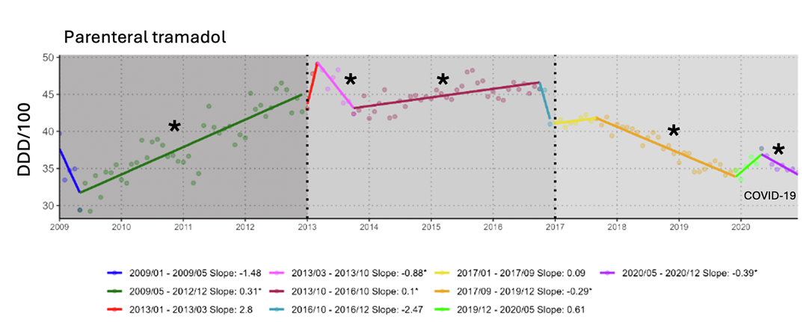
Example Time Series Graph
Asterisks denote slopes differ significantly from 0 at the p=0.01 level

Slide 9
Summary
Able to use time series analysis to measure the trends of 12 different opioids between 2009 and 2020 in 4 year intervals
There were several variations in hospital use, with significant changes in usage due to the COVID-19 pandemic
Highlights the importance of monitoring opioid use and good prescribing practices in hospitals to help prevent an opioid crisis in Brazil

Slide 10
Source
Carvalho, R. M., Bastos, F. I., de Magalhães-Barbosa, M. C., Bianchi, L. M., Robaina, J. R., Rodrigues-Santos, G., ... & Prata-Barbosa, A. (2025). A time-series analysis of the use of opioid medications in a network of Brazilian hospitals, 2009–2020. The Lancet Regional Health–Americas, 48.

